Slide 1
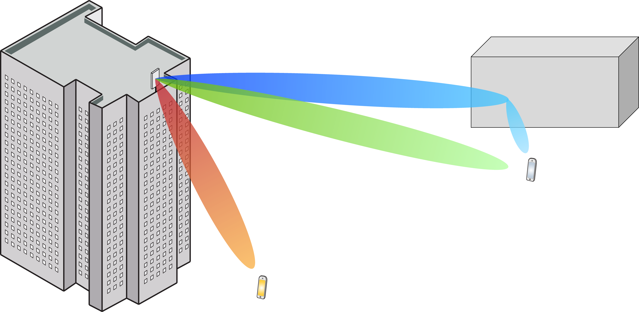
Multiple Antenna Communications
Lecture 14:
Practical Aspects and Outlook
Emil Björnson

Slide 2
Outline
Role of multiple antenna communications
Enhanced data rates
Reliability and coverage
Practical aspects
Analog, digital, hybrid beamforming
Polarization, subarrays, 3D beamforming
Outlook towards the future

Slide 3
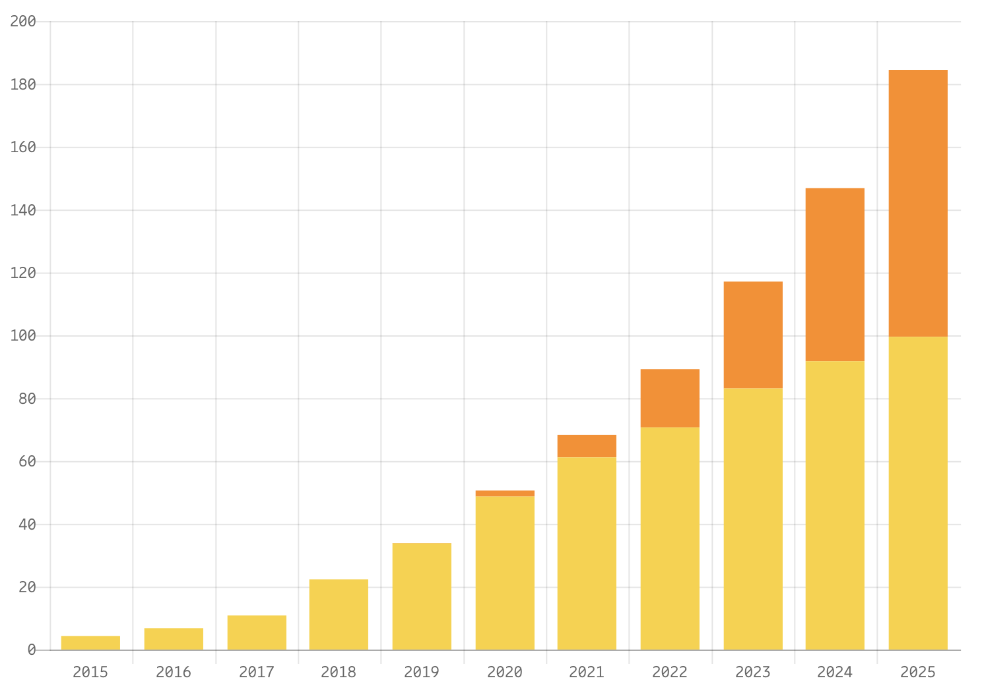
Data traffic grows exponentially
EB/month
More traffic per device
Require higher data rate
Users active more often
5G
4G
3G
2G
45% annual growth
Impact of multiple antenna communications?
Data: Ericsson Mobility Report 2021

Slide 4
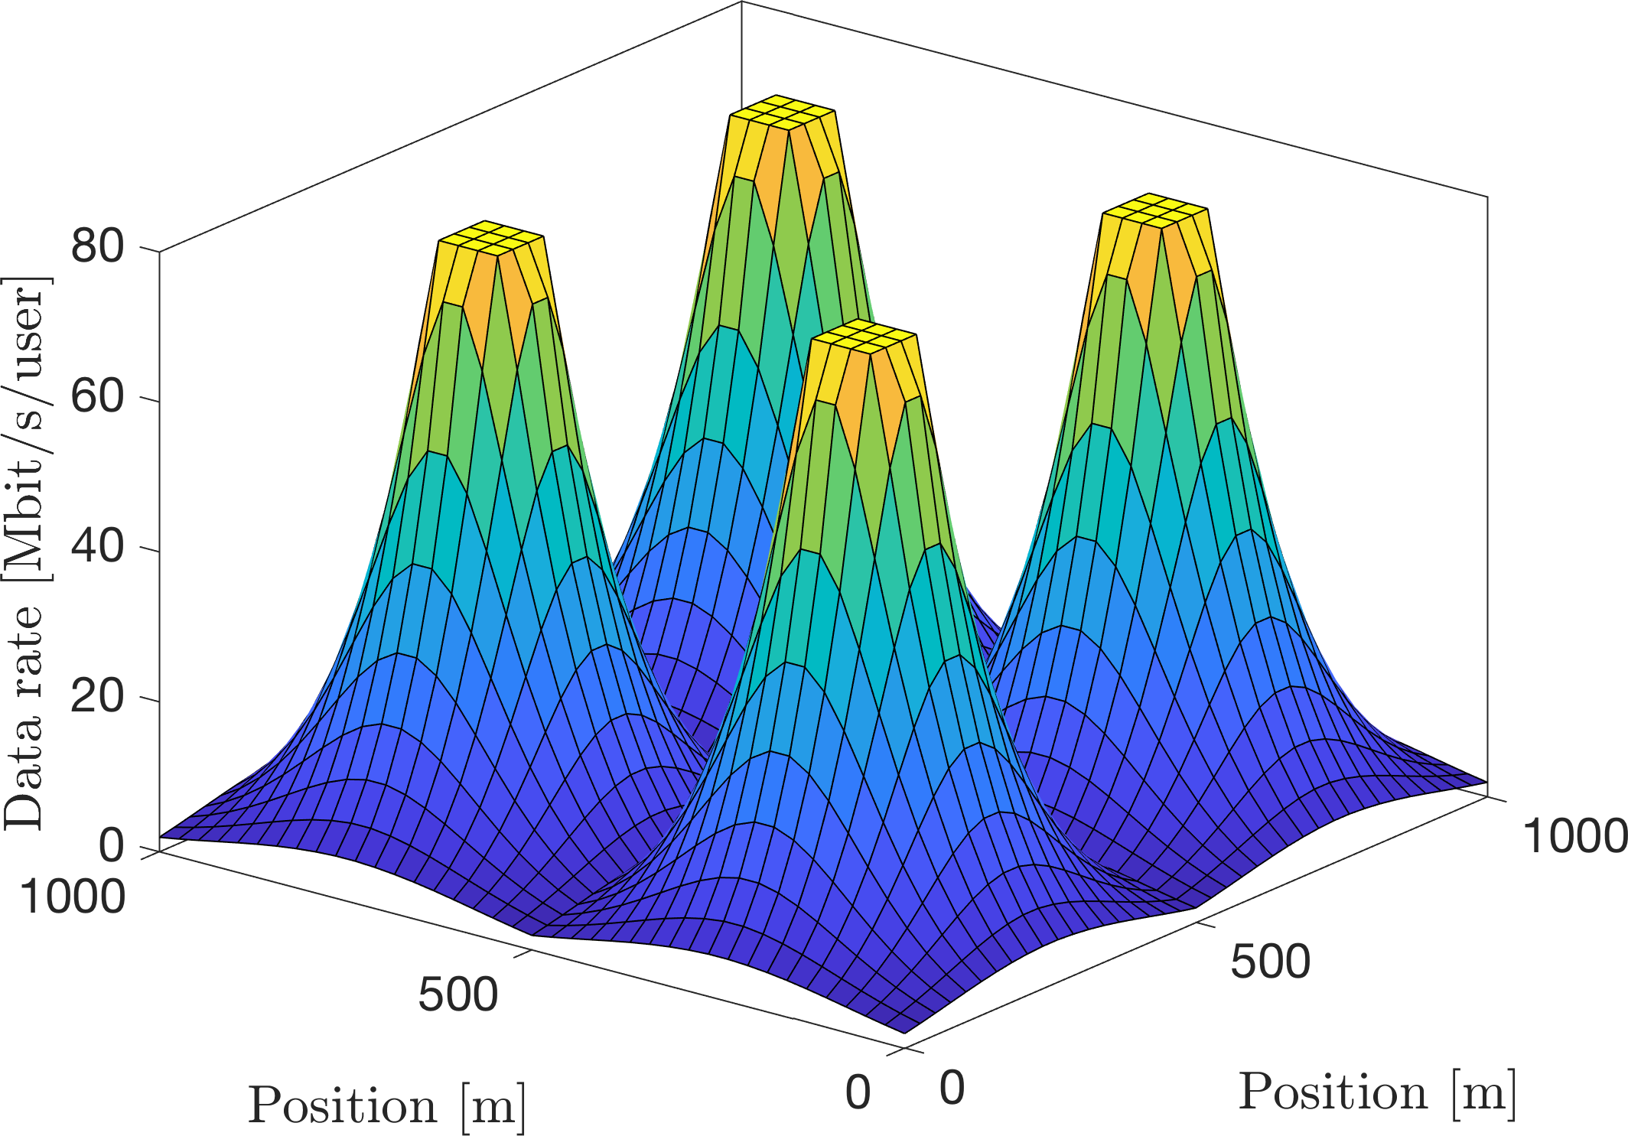
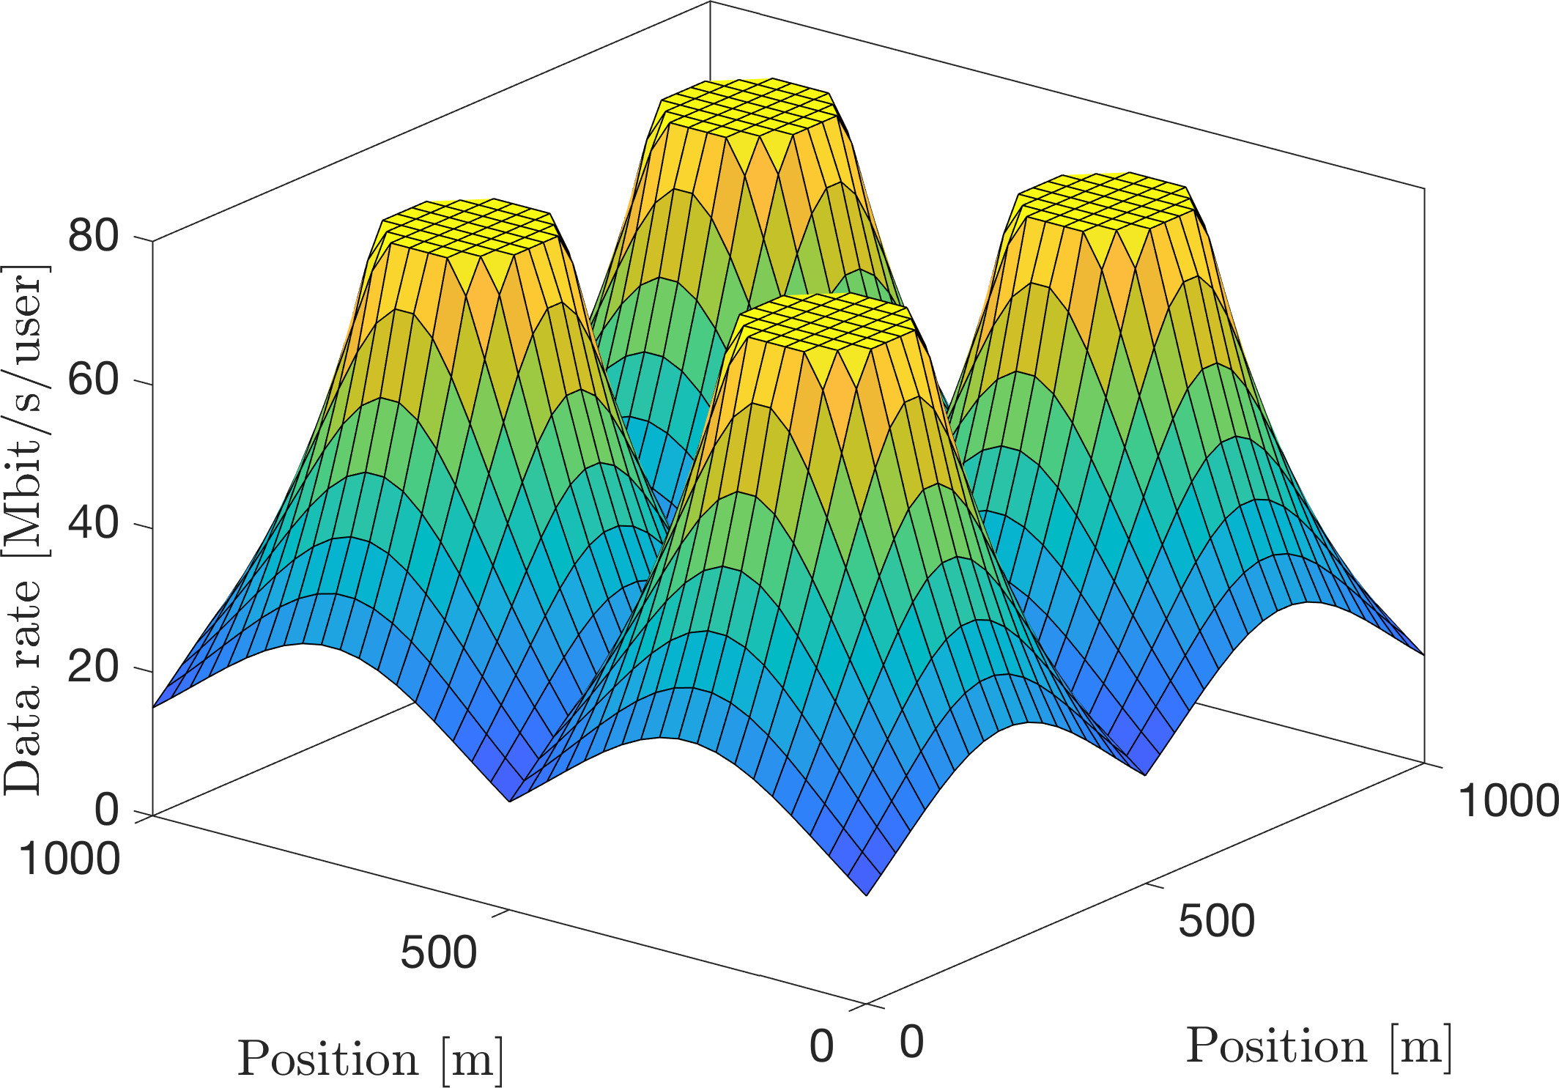
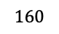
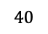
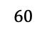
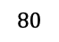
Point-to-point MIMO: Better user performance
$$160$$
$$80$$
$$60$$
$$40$$
Beamforming and multiplexing gain

Slide 5
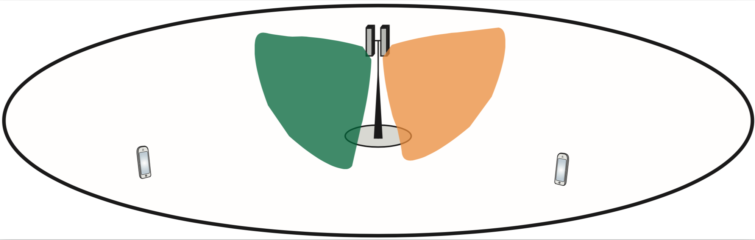
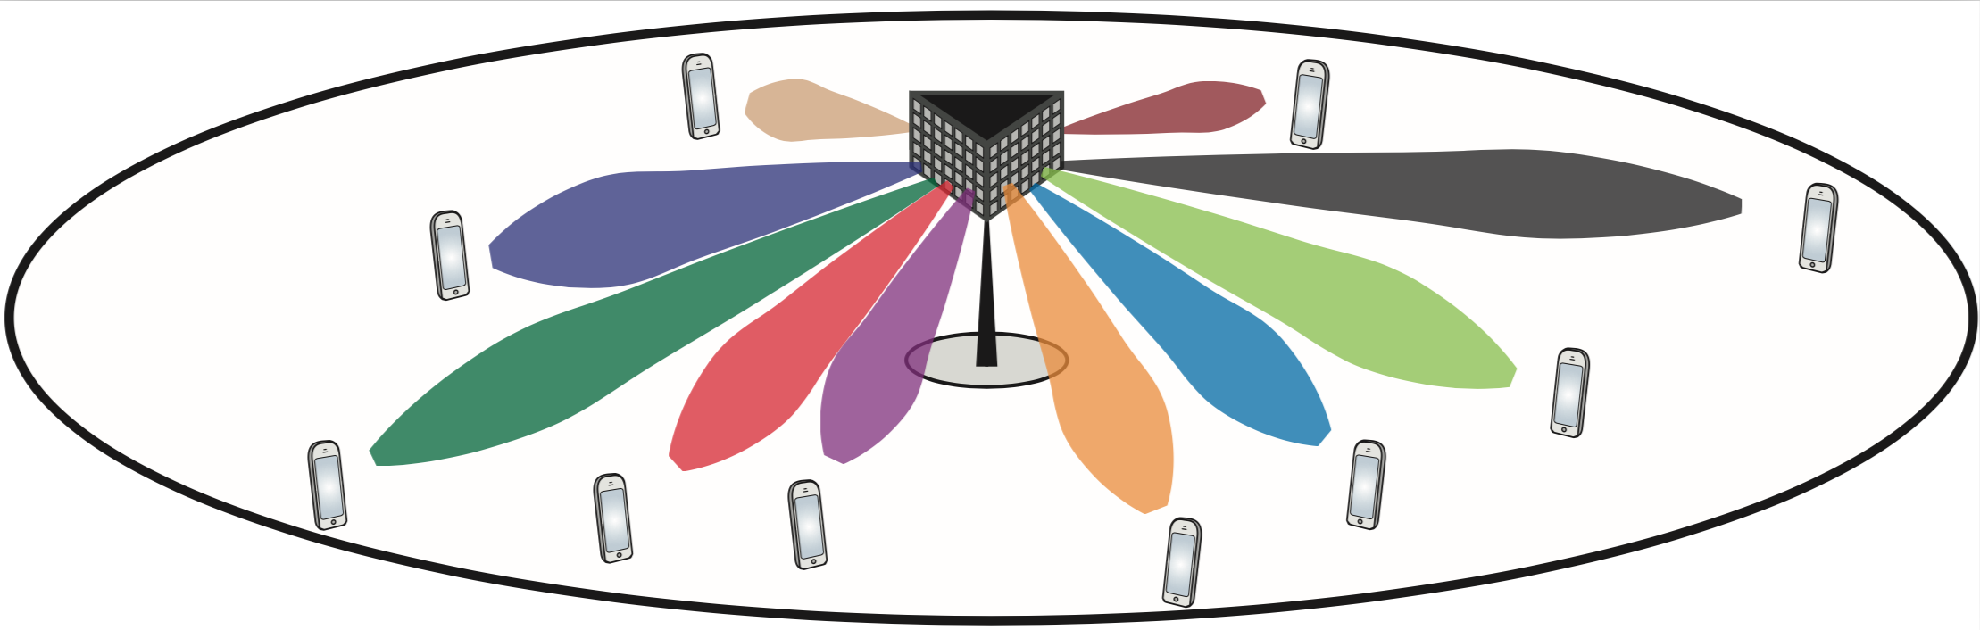
Multi-user MIMO: Spatial multiplexing of users
Few antennas (elements): Broad beams
Serve many users at same time/frequency resource
Narrow beams limit interference
Massive number of antennas: Narrow beams

Slide 6
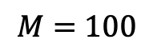
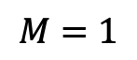
Beyond enhanced data rate
$$M=100$$
Ultra-reliable low-latency communication (URLLC)
Channel hardening alleviates channel fading
Fewer retransmissions, predictable performance
Massive machine-type communication (mMTC)
Extend coverage, more cost-efficient deployment
Reduce transmit power for battery-power devices
$$M=1$$

Slide 7
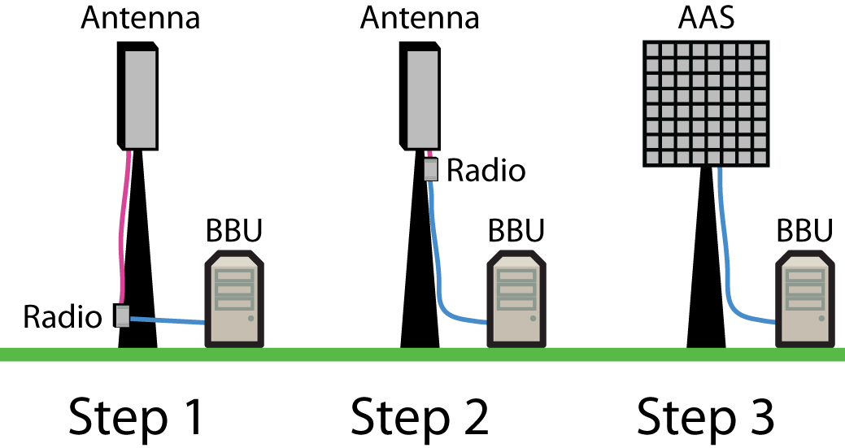
Passive and active antennas
Passive
antenna
Passive
antenna
Array of active antennas:
Antenna-integrated radios
Massive
MIMO
Can be placed in an edge cloud
Evolution:
Radio = Also called transceiver chain
BBU = Baseband unit

Slide 8
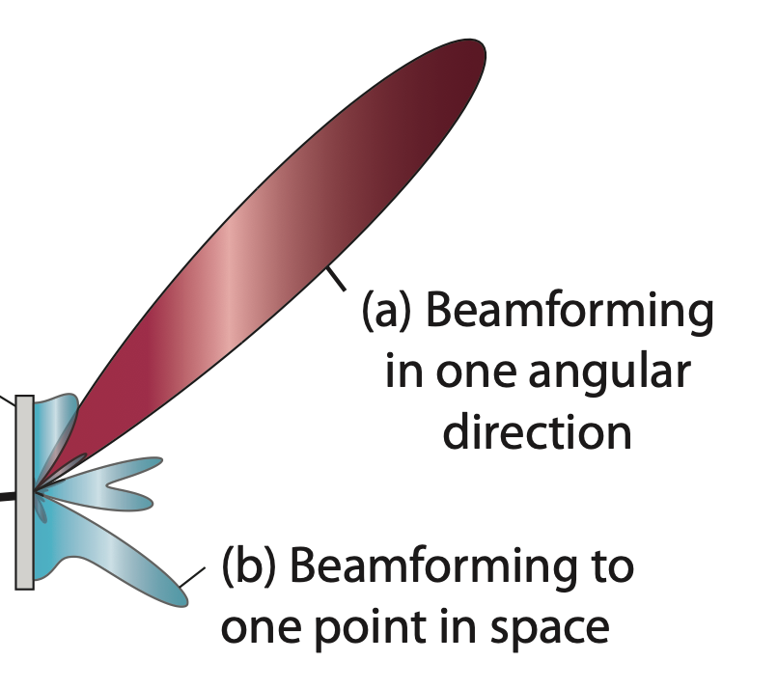
Beamsteering and (generalized) beamforming
Beamsteering
Beam in one angular direction
Not associated with any user
Beamforming
Beam in one angular direction
Designed for line-of-sight user
Generalized beamforming
Superposition of beams
Designed for a non-line-of-sight user

Slide 9
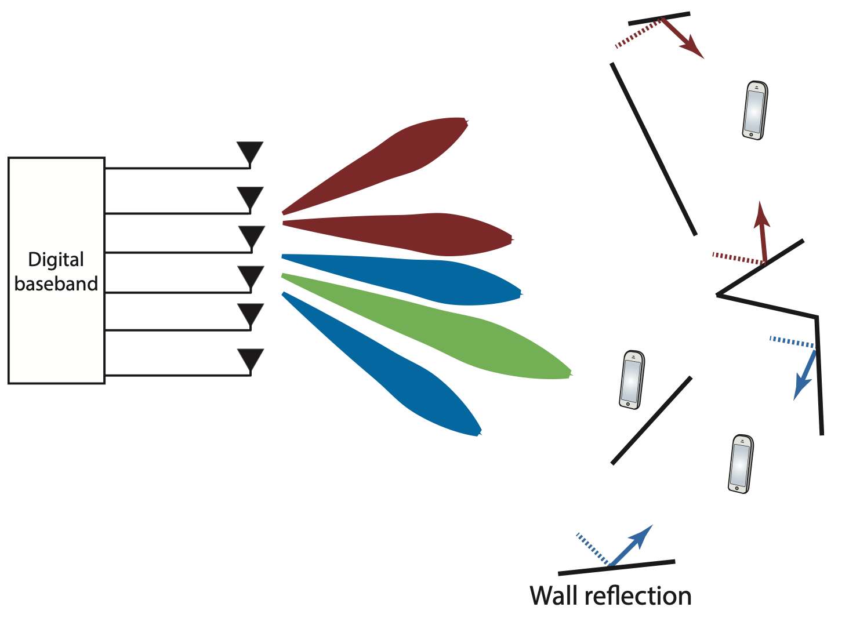
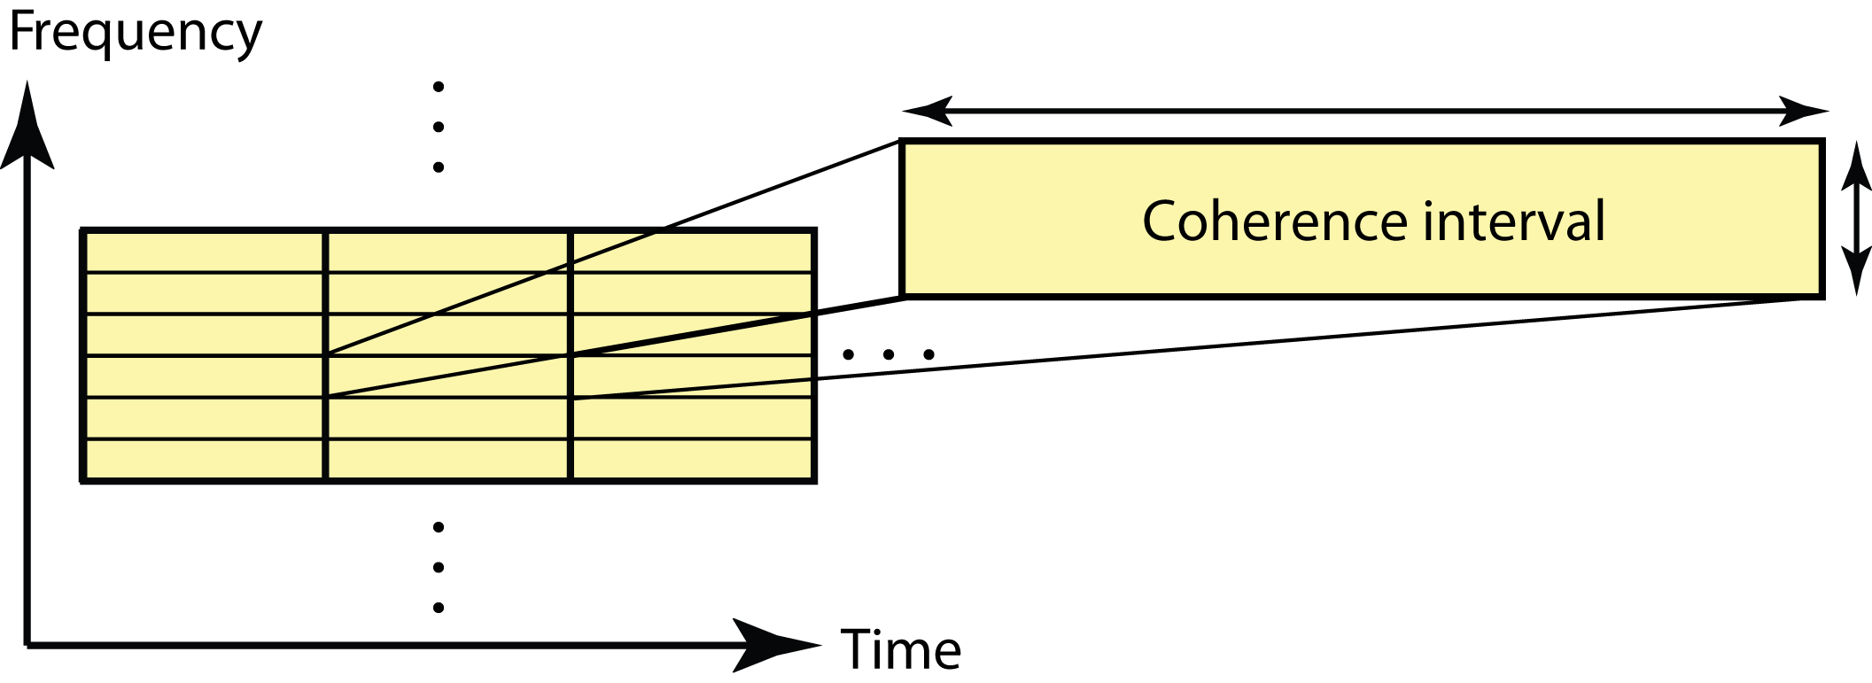
Digital beamforming
Full flexibility to create a superposition of beams
Adapt to multipath
Vary power over antennas
Vary over frequency domain
Precoding
Multi-user/layer beamforming

Slide 10
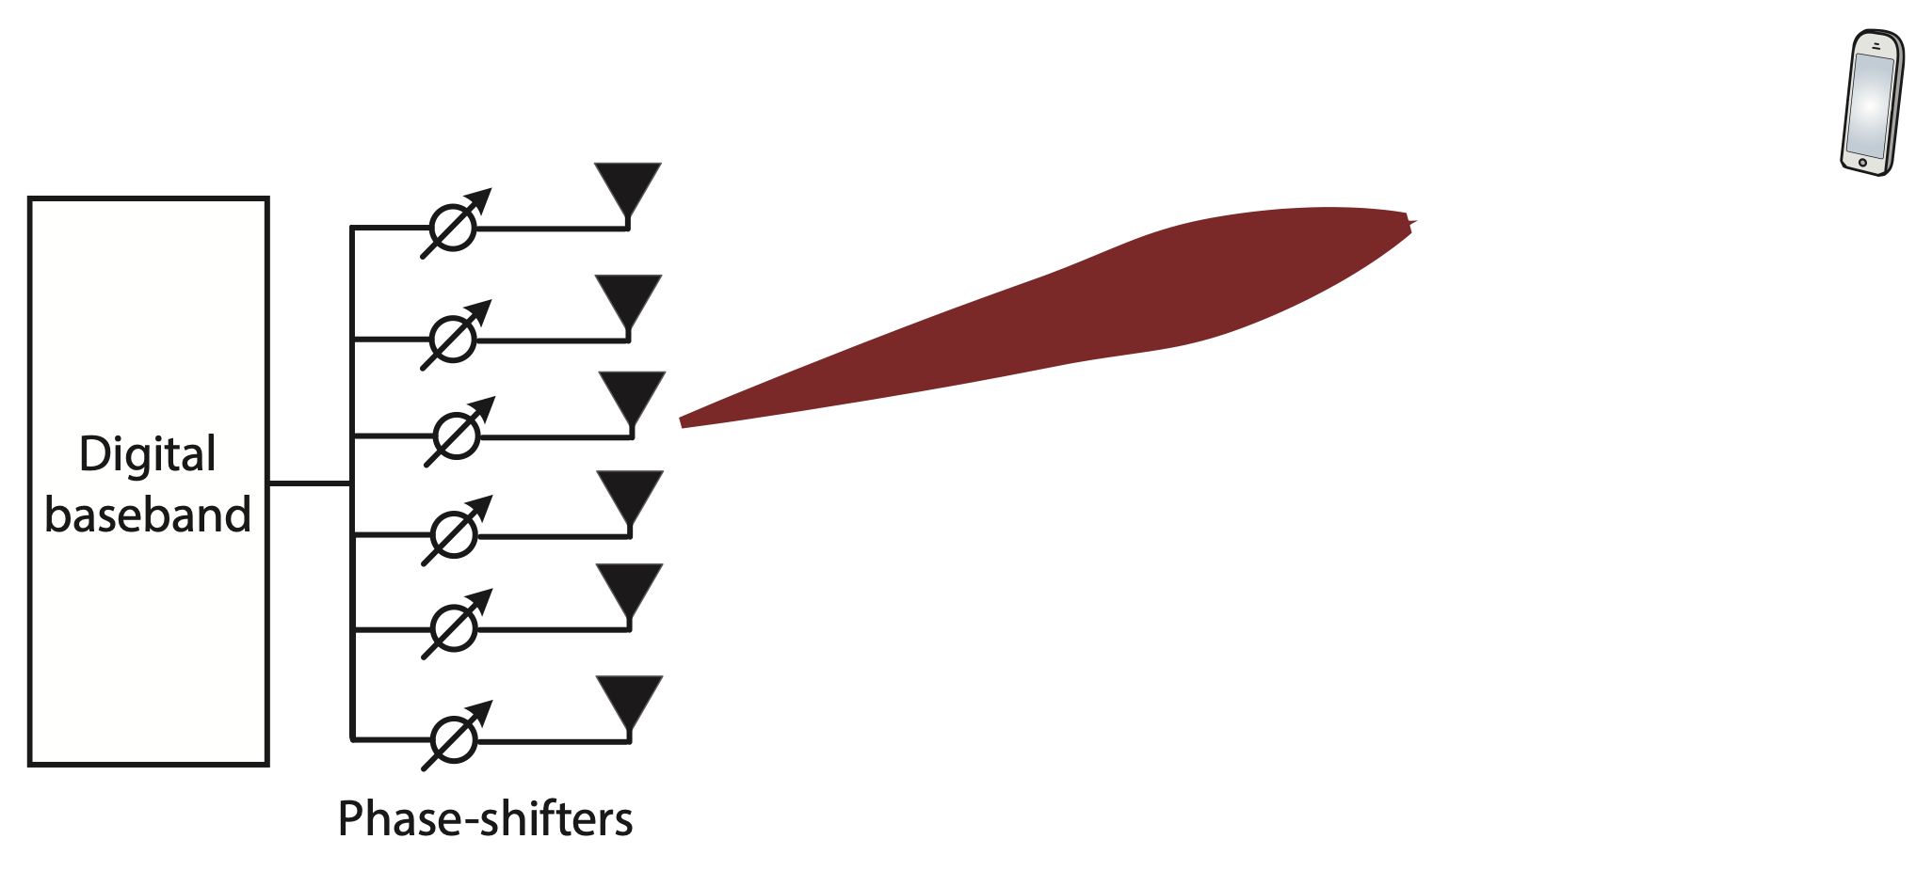
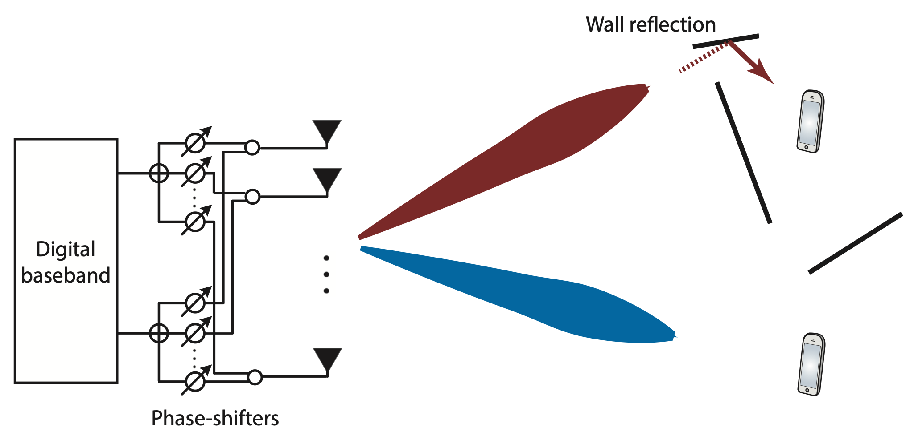
Analog and hybrid beamforming
Hybrid beamforming
Create a few beams, perform digital beamforming over them
Analog beamforming
One signal, different phase shifts
Same over frequency domain

Slide 11
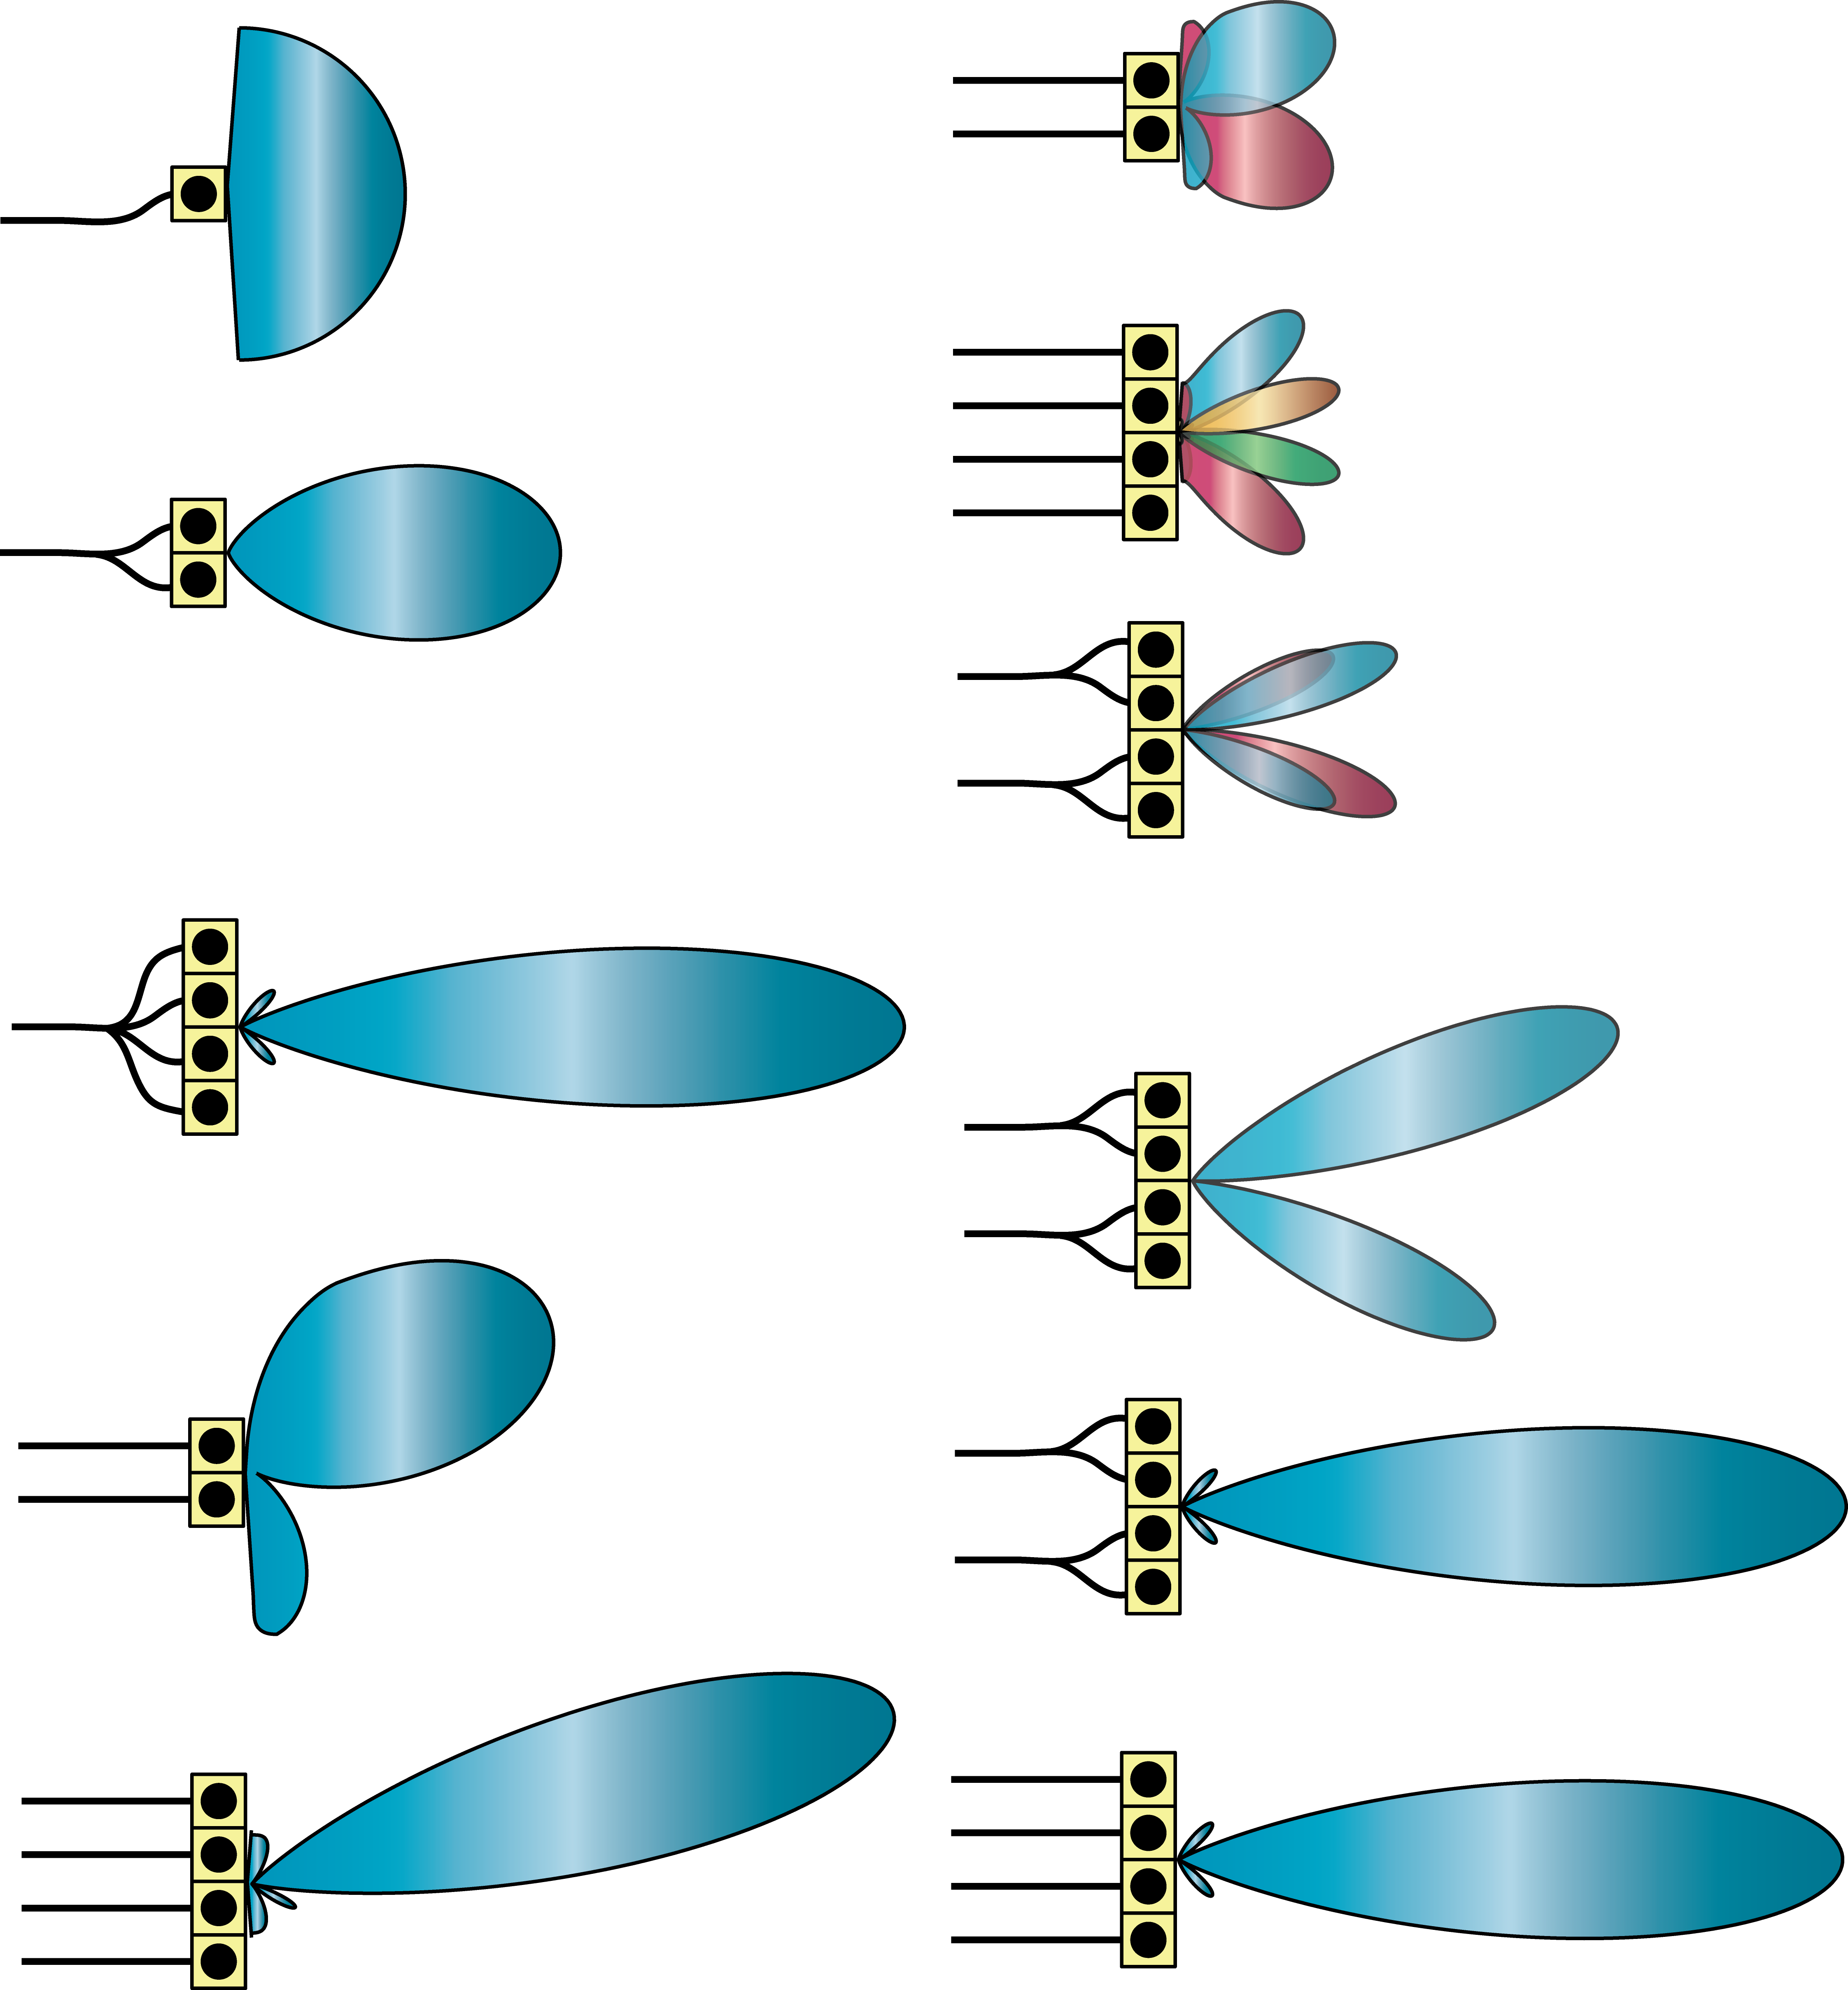
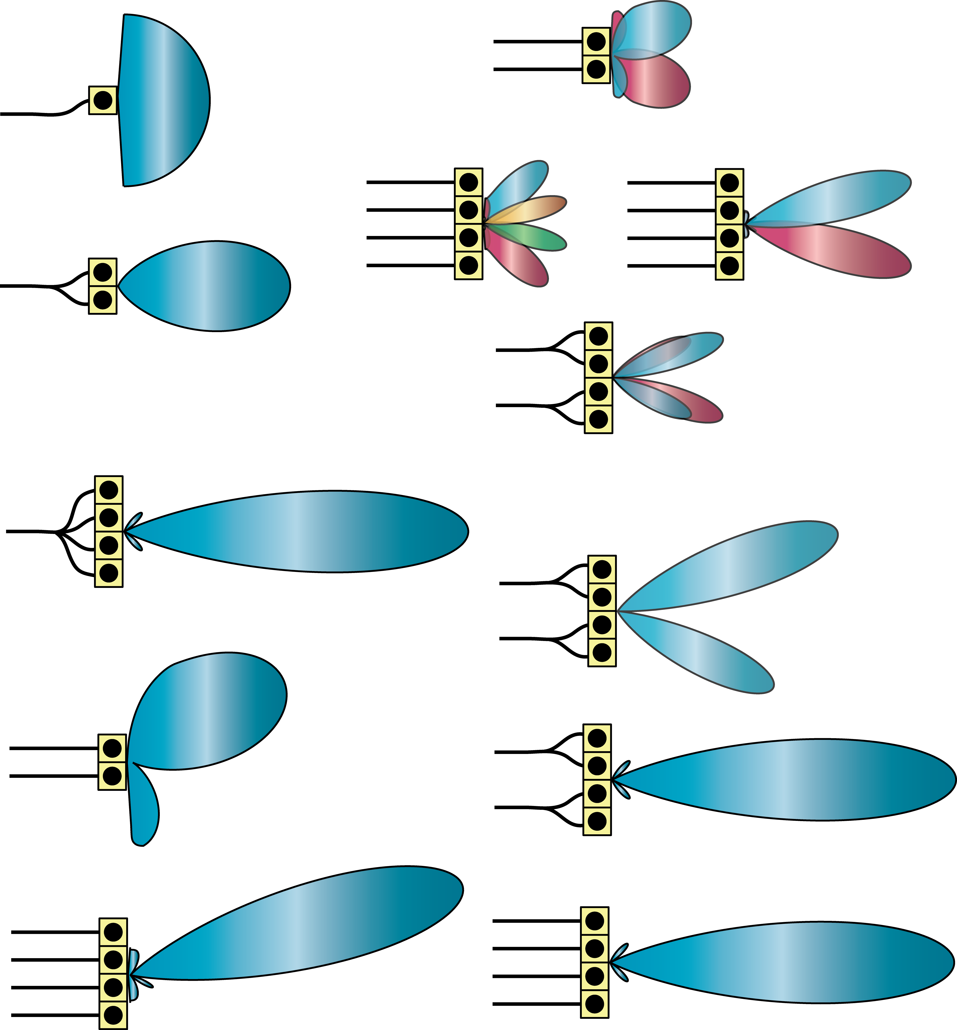
Beamforming and multiplexing gains
Four antennas:
4x signal gain
Four antennas, two signals:
Divide power between two beams
4x signal gain
Two antennas:
2x signal signal
Two antennas, two signals:
Divide power between two beams
2x signal gain

Slide 12
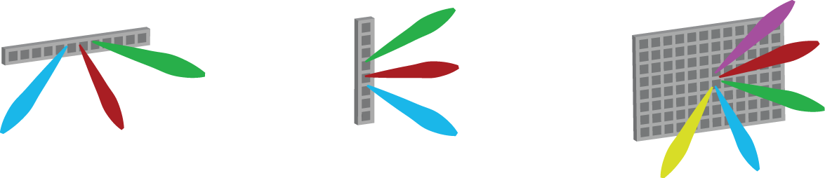
Three-dimensional beamforming
Array geometry determines possible beam directions
Horizontal linear array Azimuth beamforming
Vertical linear array Elevation beamforming
Planar array 3D beamforming

Slide 13
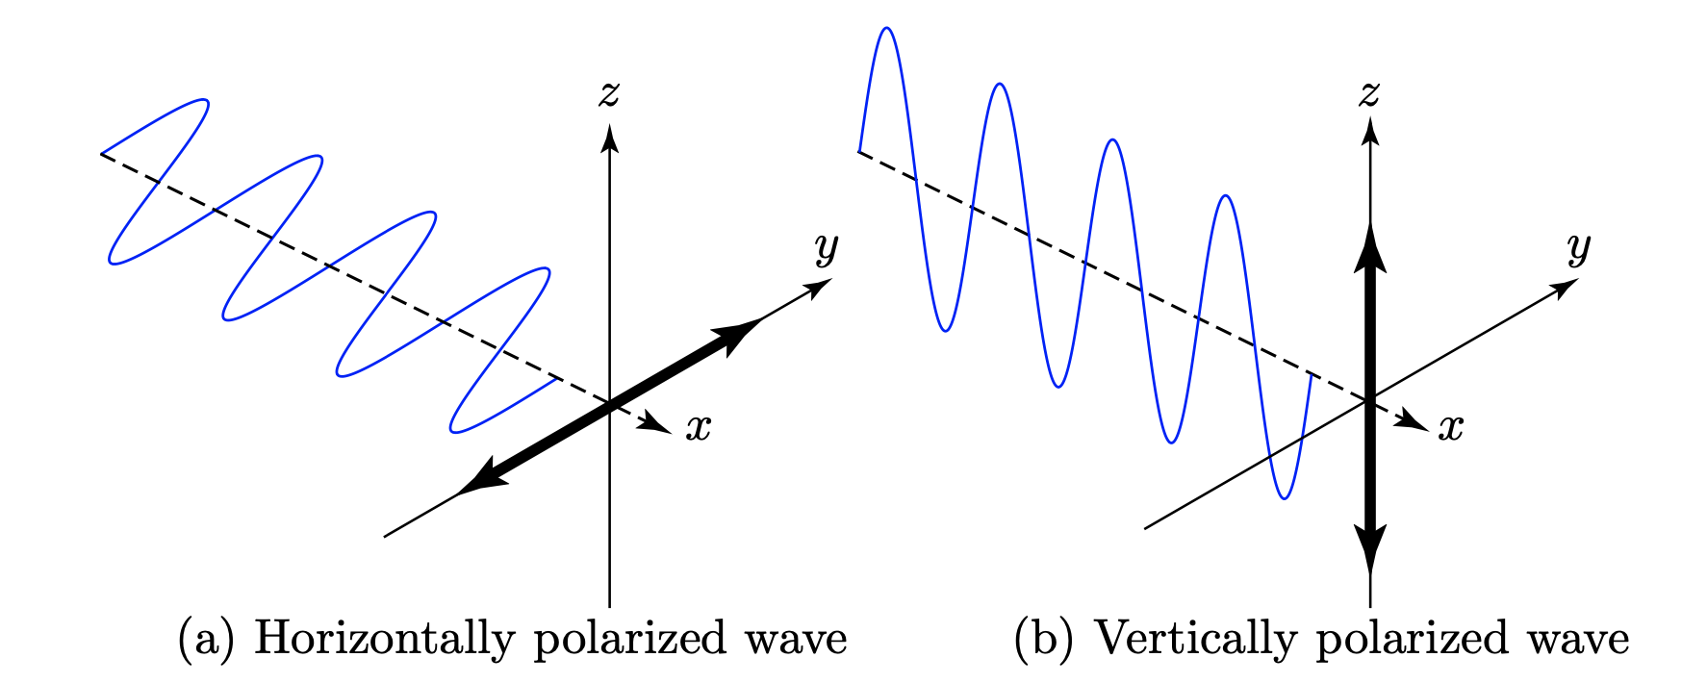
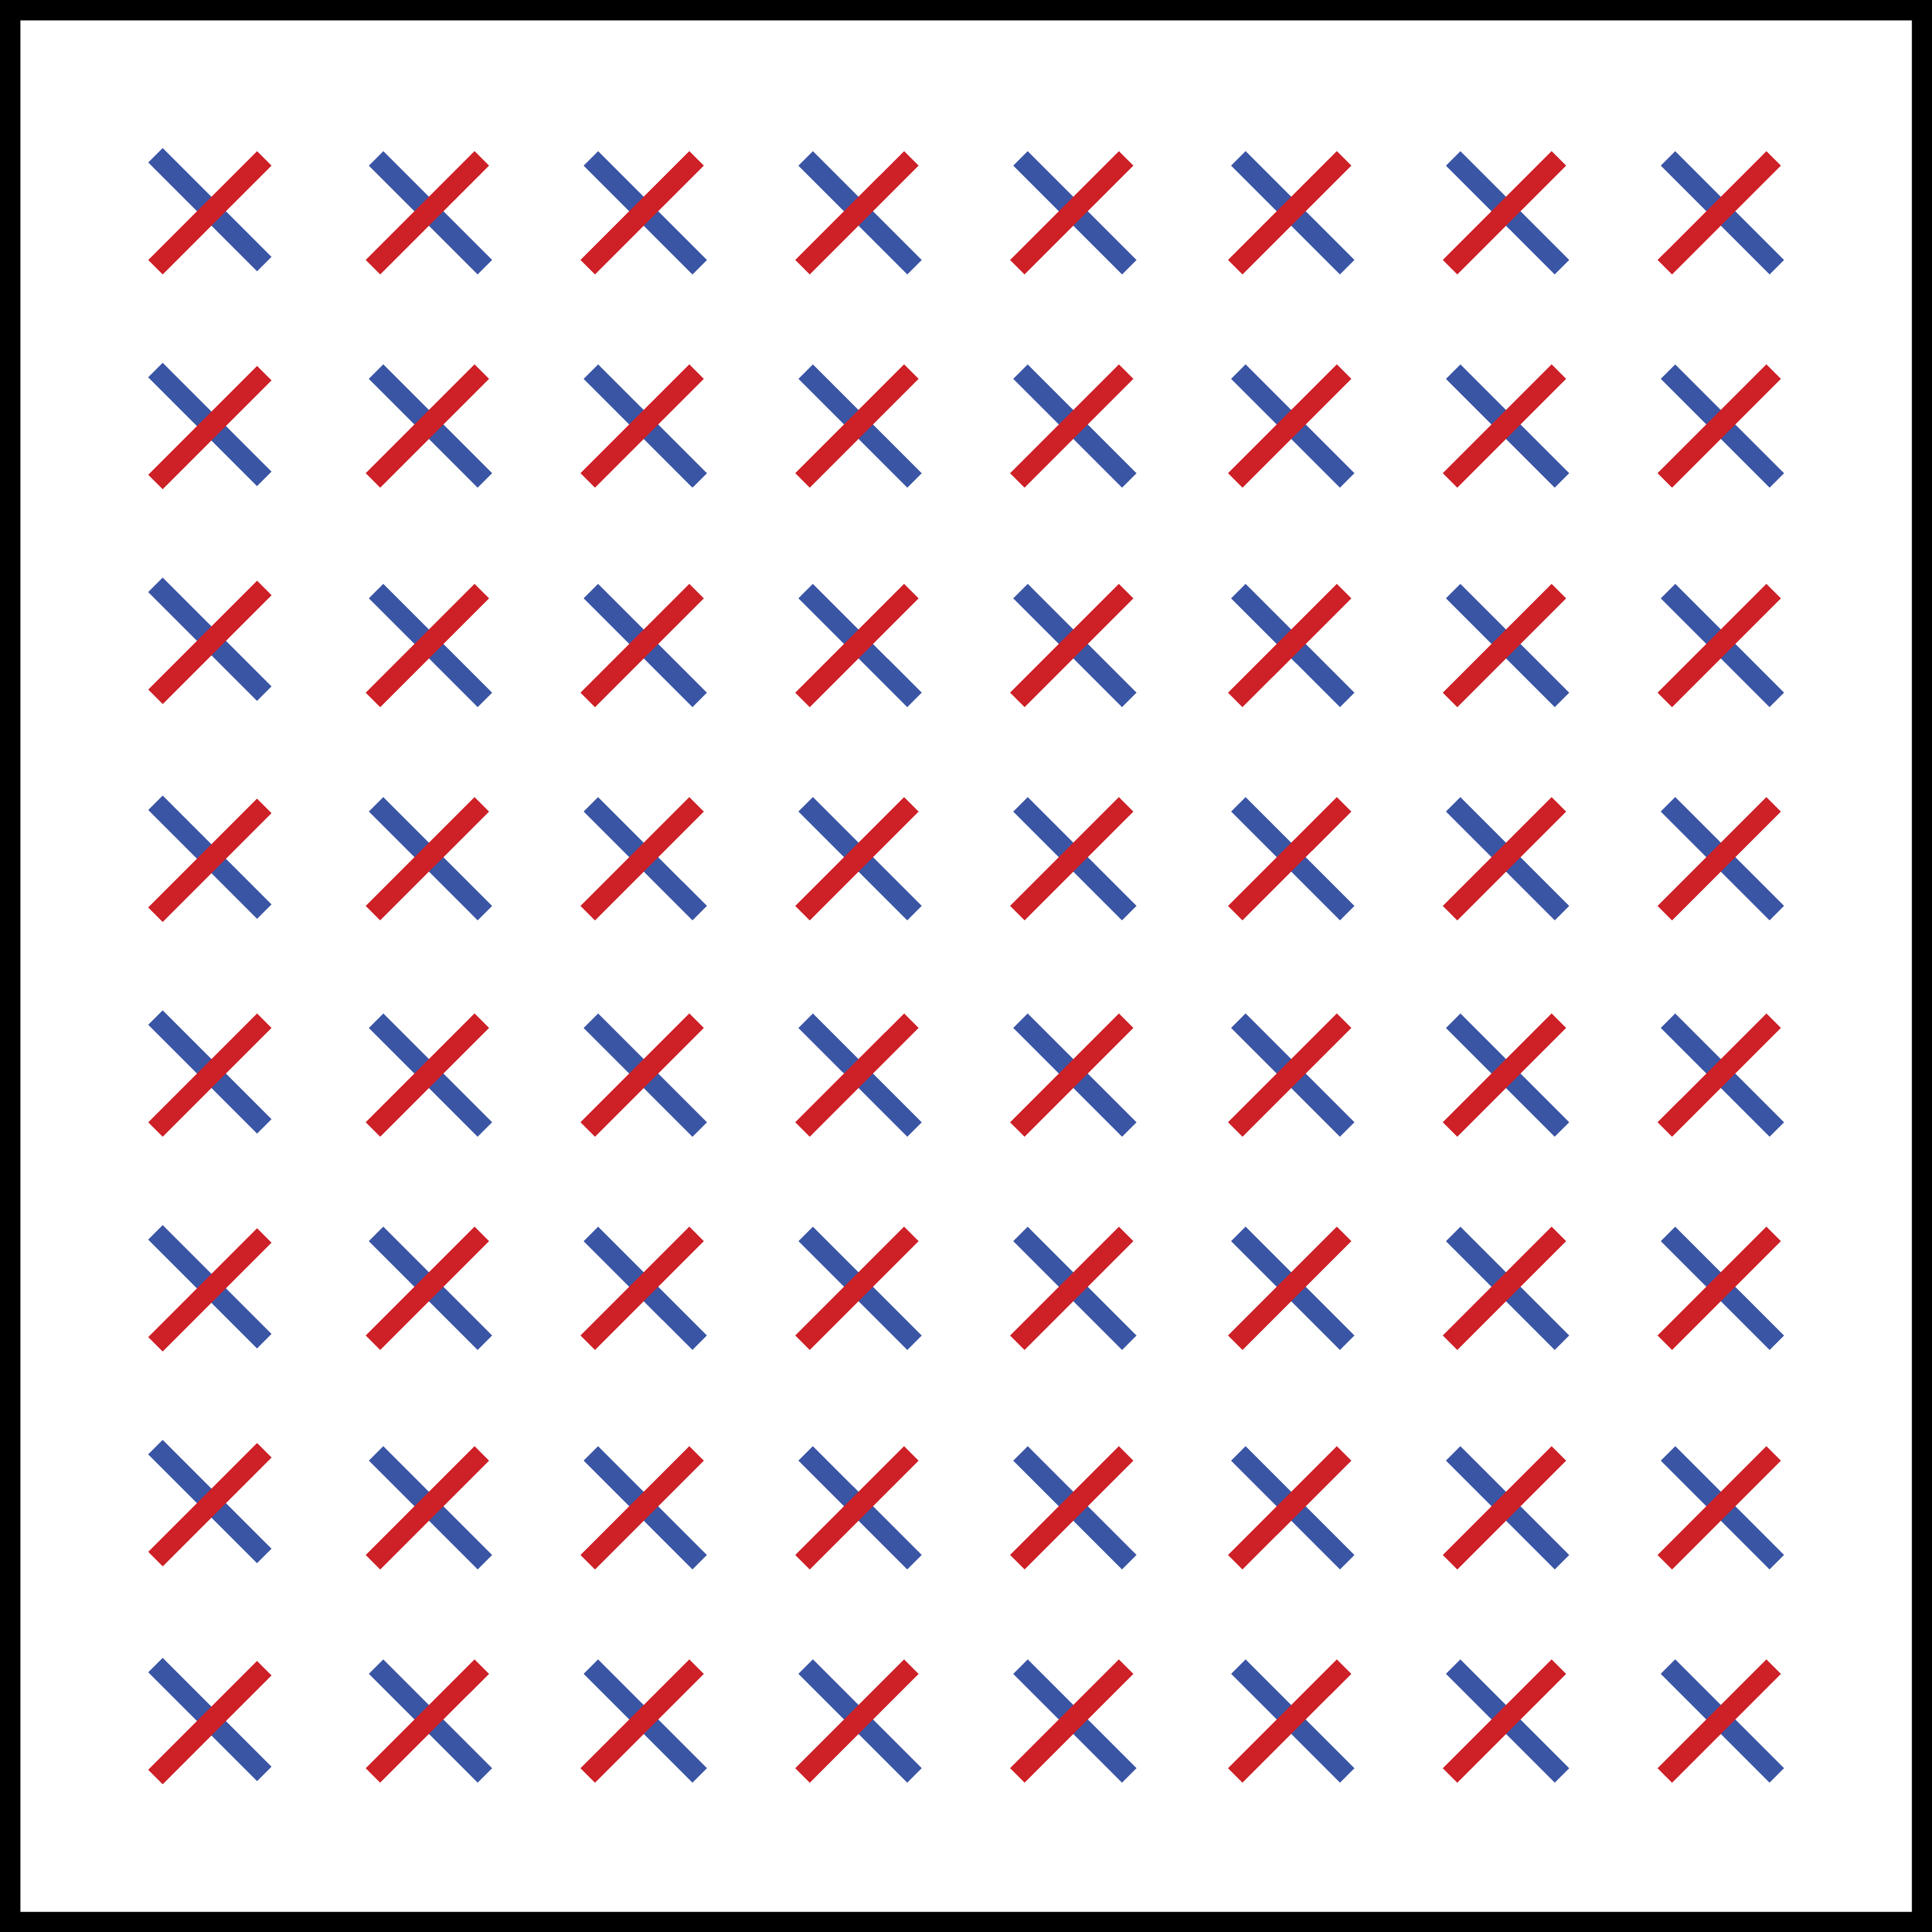
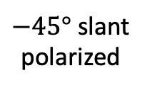
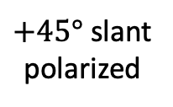
Polarization of waves and antennas
Vertically
polarized
Horizontally
polarized
$−45°$ slant
polarized
$+45°$ slant
polarized
Channel is changing the polarization
Anyway creates an extra dimension
Often used in point-to-point MIMO

Slide 14
Typical channel properties
People live on the ground
Builds have limited height
Coverage sector:
120 degrees
Smaller angular interval
Horizontal beamforming is most important

Slide 15


Planar arrays and subarrays
64 radios
(64T64R)
32 radios
(32T32R)
128 antenna elements
How many radios?
“Antenna” = Group of elements sharing one radio (transceiver chains)

Slide 16
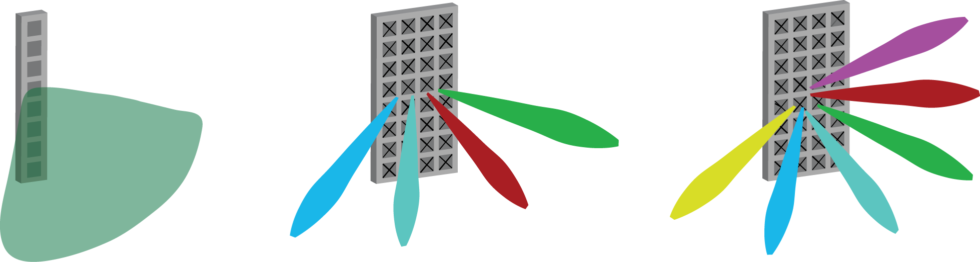
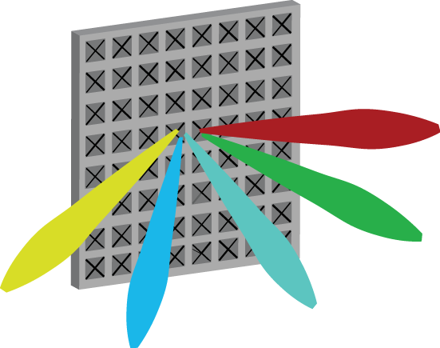
Evolution of active antenna technology
1 antenna
64 antennas
8 antennas
Passive sector antenna
8 elements (7 dBi each)
1 transceiver chain
Fixed beam 16 dBi
Classical antenna array
64 elements (32 per polarization)
8 transceivers (2 per column)
Up to 8 horizontal beams
Massive antenna array
128 elements (64 per polarization)
64 transceiver
Up to 64 3D beams

Slide 17
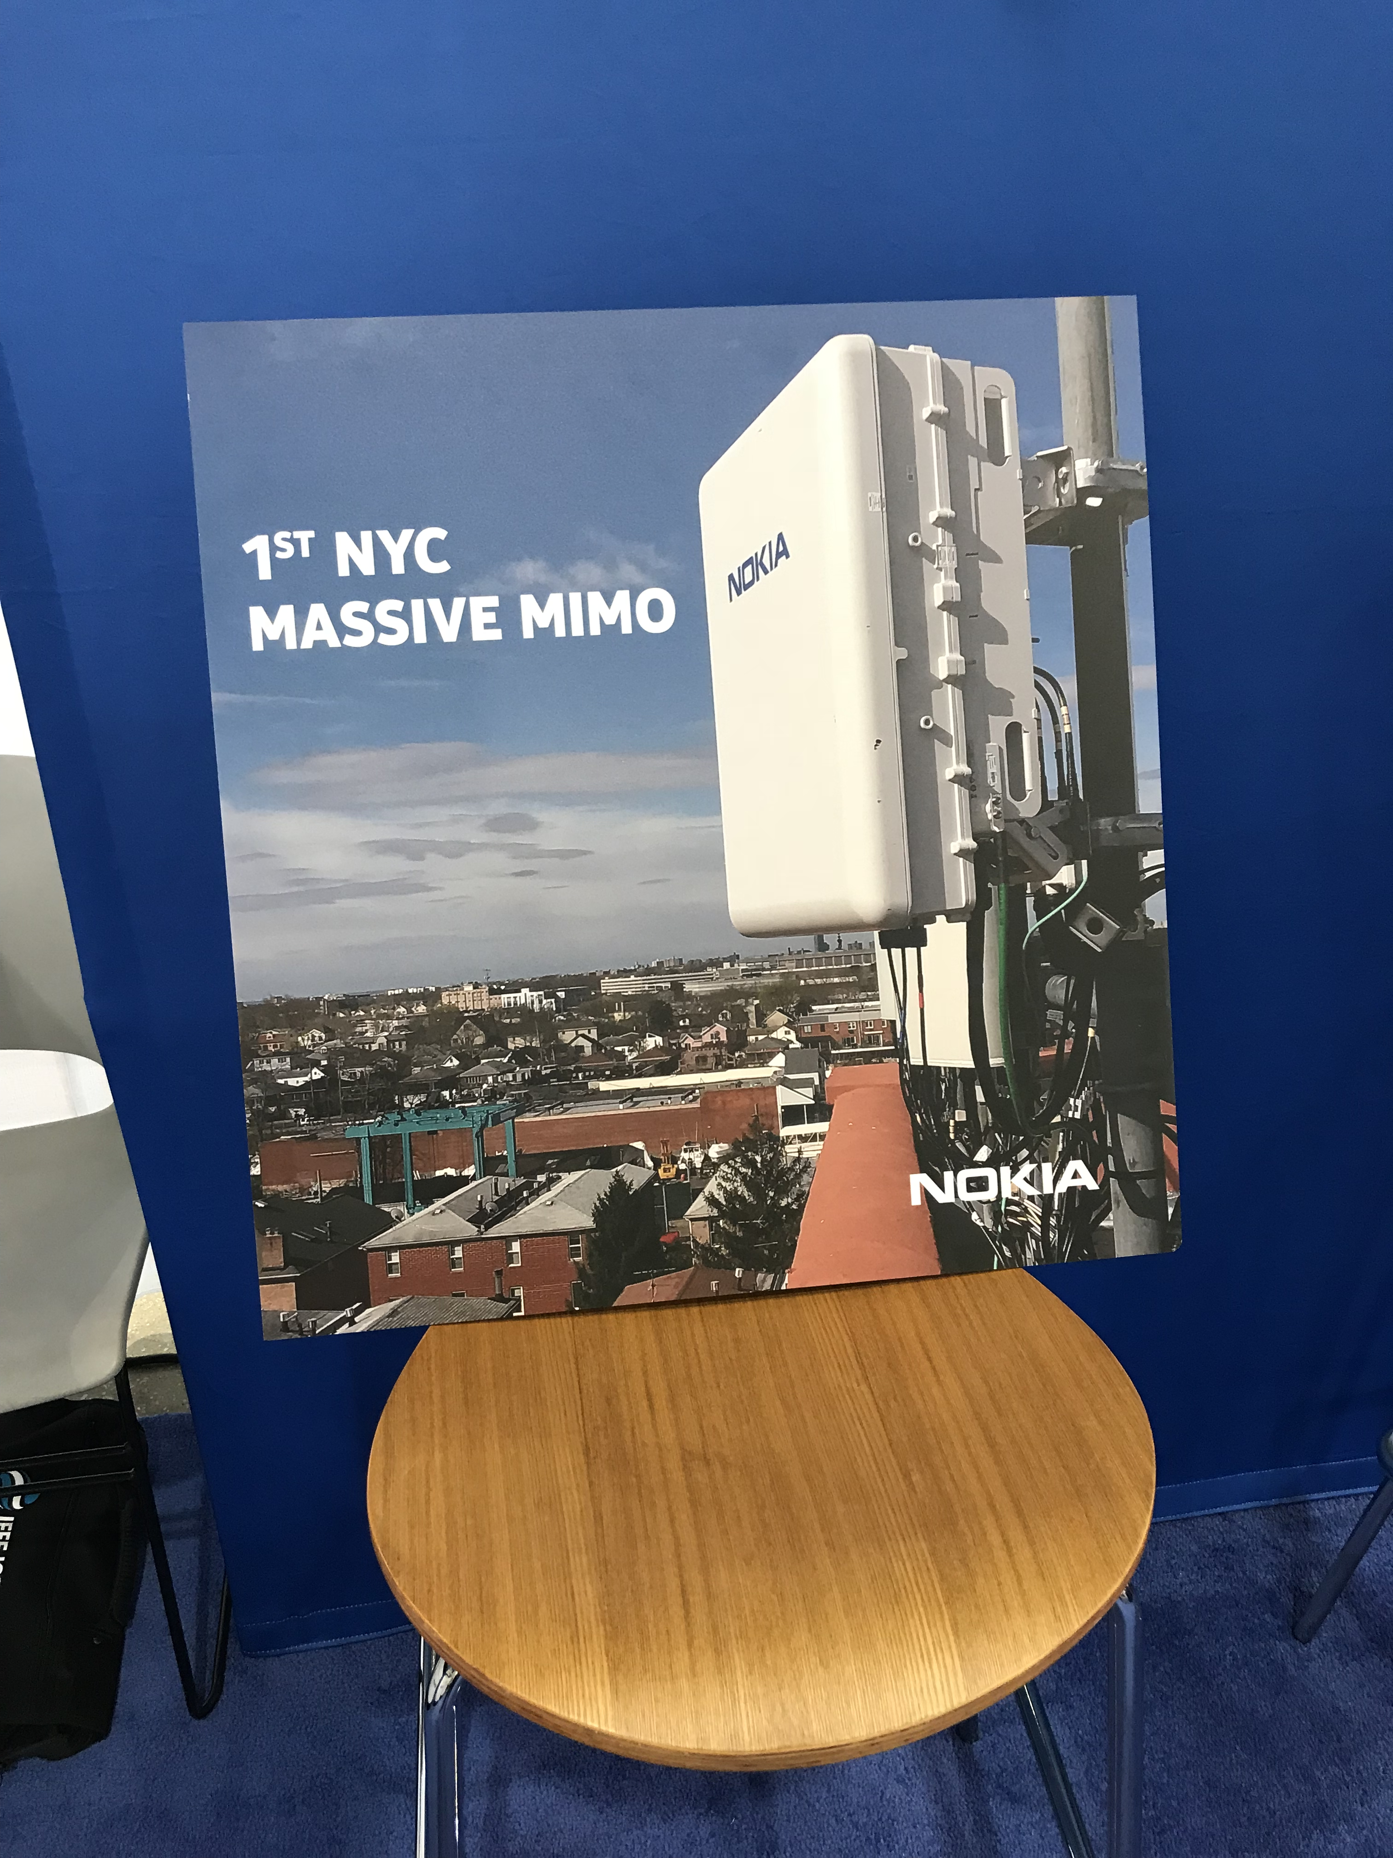
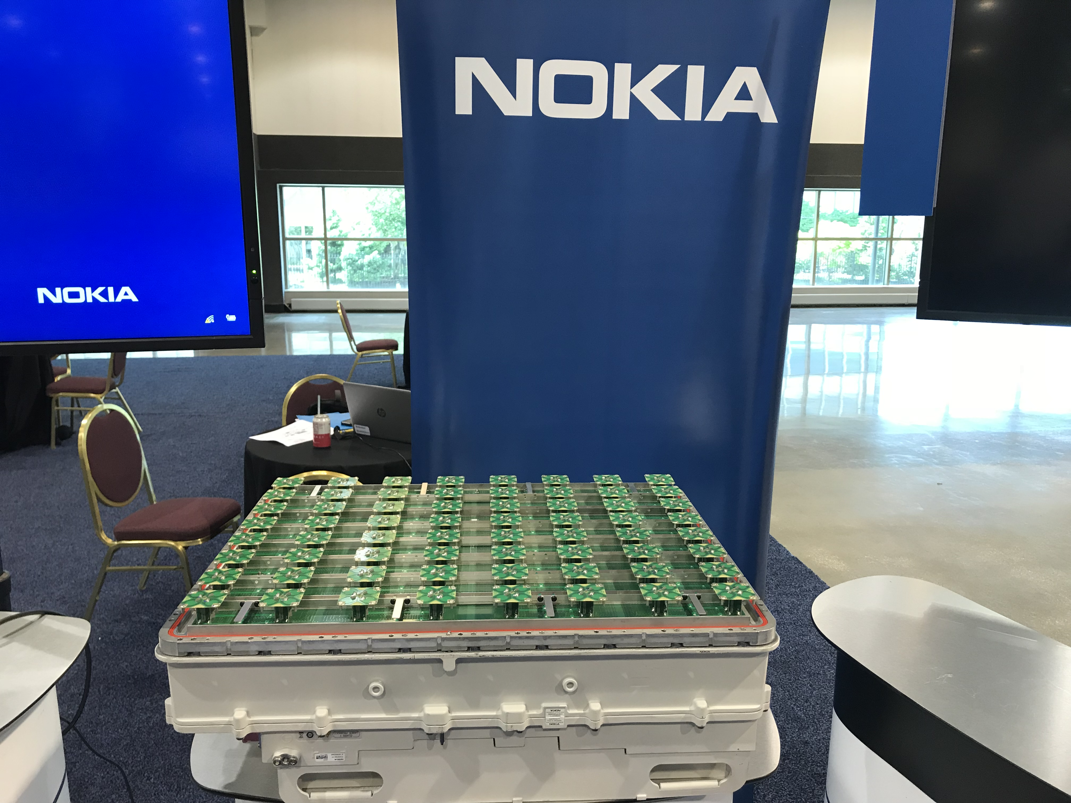
Massive MIMO in 5G
64 antennas
Photo: Erik G. Larsson, May 2018

Slide 18
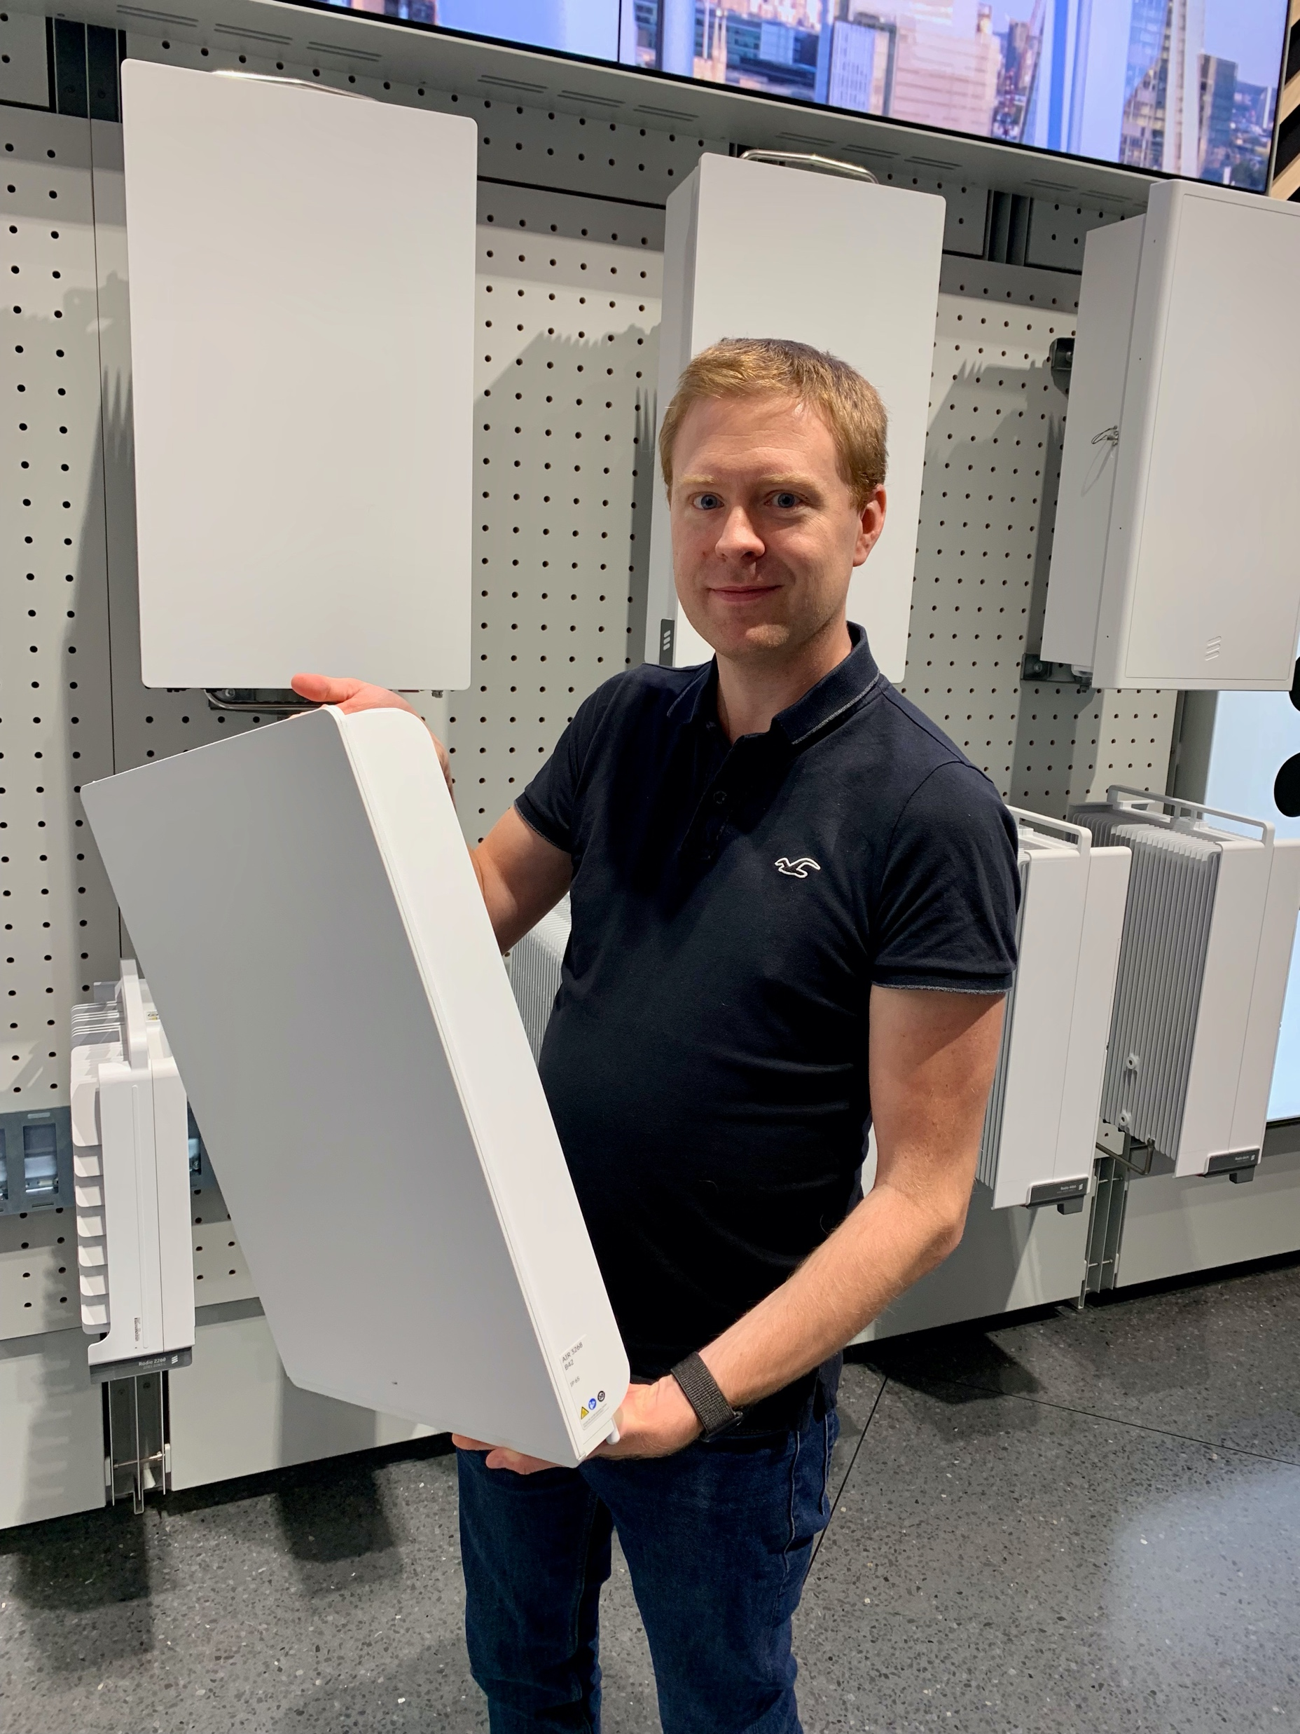
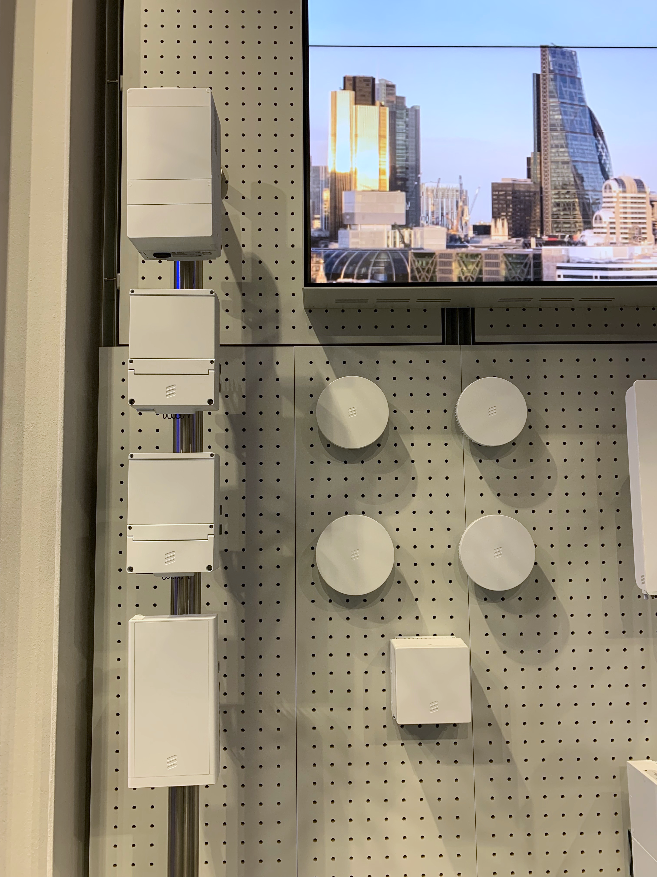
Massive MIMO in 5G: Evolution
Ericsson Street Macro 6705
Millimeter-wave band
Complete base station
Ericsson AIR 3268
3.5 GHz band
32 antennas (128 elements)
12 kg
200 W over 200 MHz
Integrated circuitry

Slide 19
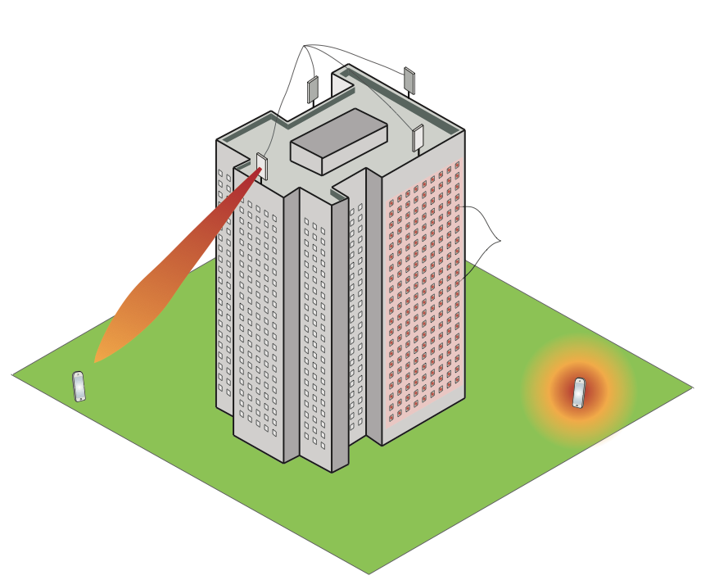
What might happen in the future?
64-antenna
Massive MIMO
New deployment concepts
3) Physically large arrays
1) Distributed Massive MIMO
(Cell-free)
2) Reconfigurable intelligent surfaces

Slide 20
What have we not covered in the course?
Point-to-point MIMO
Cases with imperfect channel knowledge
Massive MIMO
Advanced processing (multi-cell, MMSE)
More realistic channels (e.g., correlated Rayleigh fading)
Fading channels
Gradual variations, channel tracking and prediction

Slide 21
Multiple Antenna Communications
Lecture 14:
Practical Aspects and Terminologies
Emil Björnson

